Slide 2
Solid Rock or Sinking Sand
Luke 6:46-49

Slide 3
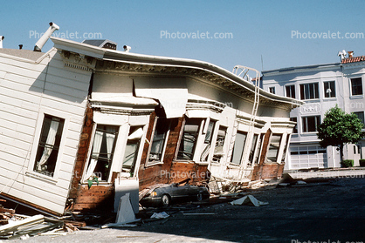

Slide 4
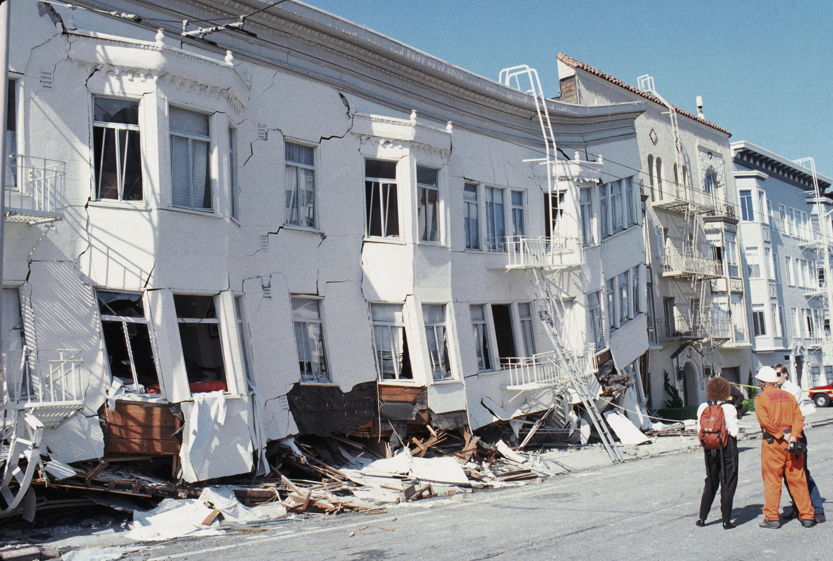

Slide 5
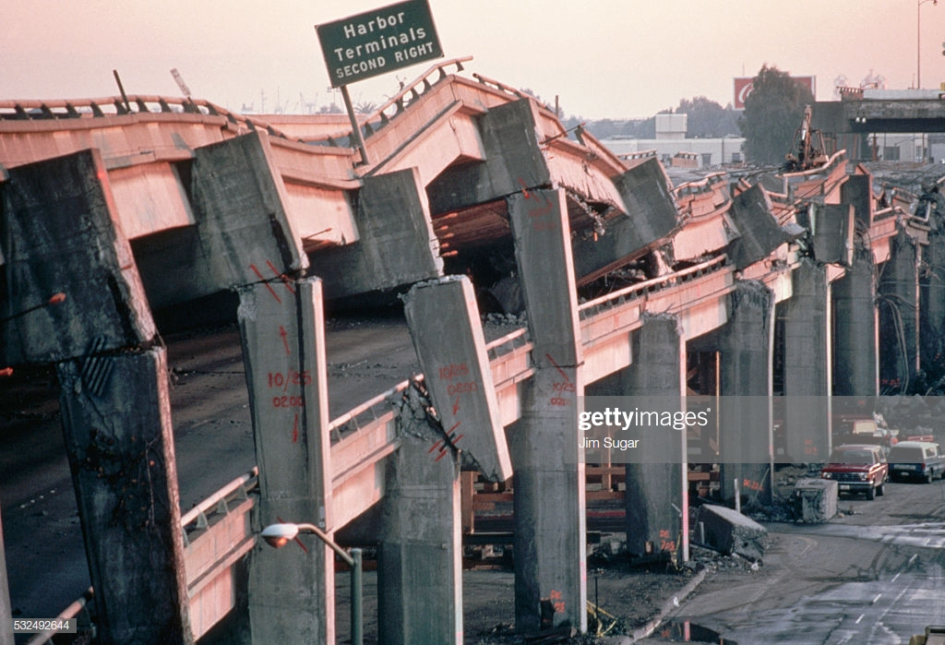

Slide 6
“Why do you call me, ‘Lord, Lord,’ and do not do what I say? I will show you what he is like who comes to me and hears my words and puts them into practice. He is like a man building a house, who dug down deep and laid the foundation on rock. When a flood came, the torrent struck that house but could not shake it, because it was well built. But the one who hears my words and does not put them into practice is like a man who built a house on the ground without a foundation. The moment the torrent struck that house, it collapsed, and its destruction was complete.”
Luke 6:46-49

Slide 7
On what, or in whom does my faith rest?

Slide 8
On what, or in whom does my faith rest?
Do not let your hearts be troubled. Trust in God; trust also in me. In my Father’s house are many rooms; if it were not so, I would have told you. I am going there to prepare a place for you. And if I go and prepare a place for you, I will come back and take you to be with me that you also may be where I am. You know the way to the place where I am going.
John 14:1-4

Slide 9
On what, or in whom does my faith rest?
We do not want you to be uninformed, brothers, about the hardships we suffered in the province of Asia. We were under great pressure, far beyond our ability to endure, so that we despaired even of life. Indeed, in our hearts we felt the sentence of death. But this happened that we might not rely on ourselves but on God, who raises the dead.
2 Corinthians 1:8-9

Slide 10
How can my faith be strengthened?

Slide 11
How can my faith be strengthened?
Through knowledge
Creation
Resurrection
Reliability of the Bible
Transformed lives

Slide 12
How can my faith be strengthened?
Through knowledge
Creation
Resurrection
Reliability of the Bible
Transformed lives
Through experience

Slide 13
How can my faith be strengthened?
Through knowledge
Creation
Resurrection
Reliability of the Bible
Transformed lives
Through experience
I love you, O LORD, my strength.
The LORD is my rock, my fortress and my deliverer; my God is my rock, in whom I take refuge. He is my shield and the horn (strength) of my salvation, my stronghold.
I call to the LORD, who is worthy of praise, and I am saved from my enemies.
Psalm 18:1-3

Slide 14
