Slide 1
VISION

Slide 2
Stay Thirsty
Revelations 3:14-20
VISION

Slide 3
I will put the goals and interests of others above my own. (Phil. 2:3-4)
I will live an open and honest life before others (Eph. 4:25).
I will give and receive spiritual correction within scriptural limits. (Pr. 27:6; Heb. 3:13)
I will pursue repairing troubled and damaged relationships. (Rm. 12:18; Col. 3:12-13)
I will participate in the ministry of the church. (1 Peter 4:10)
I will support the ministry of my church financially. (1 Cor. 16:2)
I will follow spiritual leadership within scriptural limits, and make it a joy for them to lead. (Heb. 13:17)
VISION

Slide 4
“And to the angel of the church in Laodicea write: ‘The words of the Amen, the faithful and true witness, the beginning of God's creation.
¹⁵ “‘I know your works: you are neither cold nor hot. Would that you were either cold or hot! ¹⁶ So, because you are lukewarm, and neither hot nor cold, I will spit you out of my mouth. ¹⁷ For you say, I am rich, I have prospered, and I need nothing, not realizing that you are wretched, pitiable, poor, blind, and naked.
Revelation 3:14-17
VISION

Slide 5
“And to the angel of the church in Laodicea write: ‘The words of the Amen, the faithful and true witness, the beginning of God's creation.
¹⁵ “‘I know your works: you are neither cold nor hot. Would that you were either cold or hot! ¹⁶ So, because you are lukewarm, and neither hot nor cold, I will spit you out of my mouth. ¹⁷ For you say, I am rich, I have prospered, and I need nothing, not realizing that you are wretched, pitiable, poor, blind, and naked.
Revelation 3:14-17
VISION

Slide 6
¹⁶ And he told them a parable, saying, “The land of a rich man produced plentifully, ^{..... 20} But God said to him, ‘Fool! This night your soul is required of you, and the things you have prepared, whose will they be?’ ²¹ So is the one who lays up treasure for himself and is not rich toward God.”
Luke 12:13-22
VISION

Slide 7
I counsel you to buy from me gold refined by fire, so that you may be rich, and white garments so that you may clothe yourself and the shame of your nakedness may not be seen, and salve to anoint your eyes, so that you may see.
Revelations 3:18
VISION

Slide 8
On the last day of the feast, the great day, Jesus stood up and cried out, “If anyone thirsts, let him come to me and drink. ³⁸ Whoever believes in me, as^{[a]} the Scripture has said, ‘Out of his heart will flow rivers of living water.’”
John 7:37-38
VISION

Slide 9
Come to me, all who labor and are heavy laden, and I will give you rest. ²⁹ Take my yoke upon you, and learn from me, for I am gentle and lowly in heart, and you will find rest for your souls.
Matthew 11:28-29
VISION

Slide 10
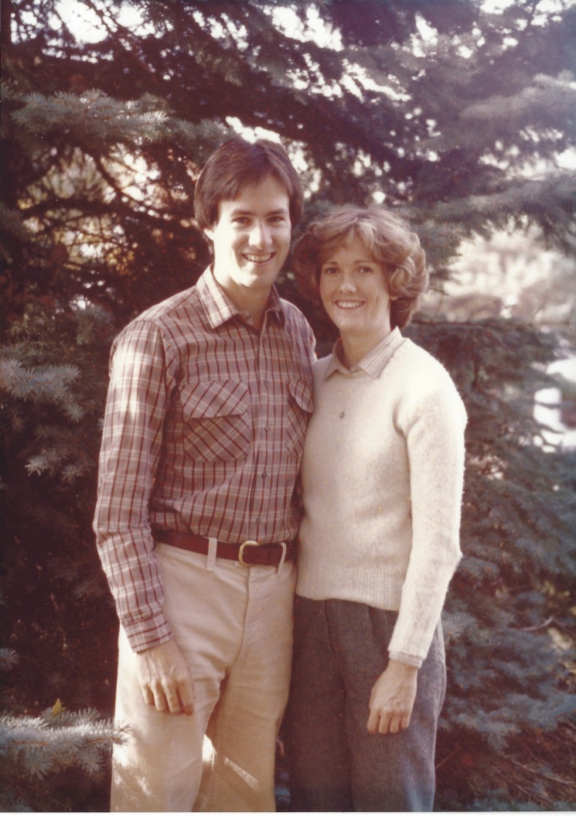
VISION

Slide 11
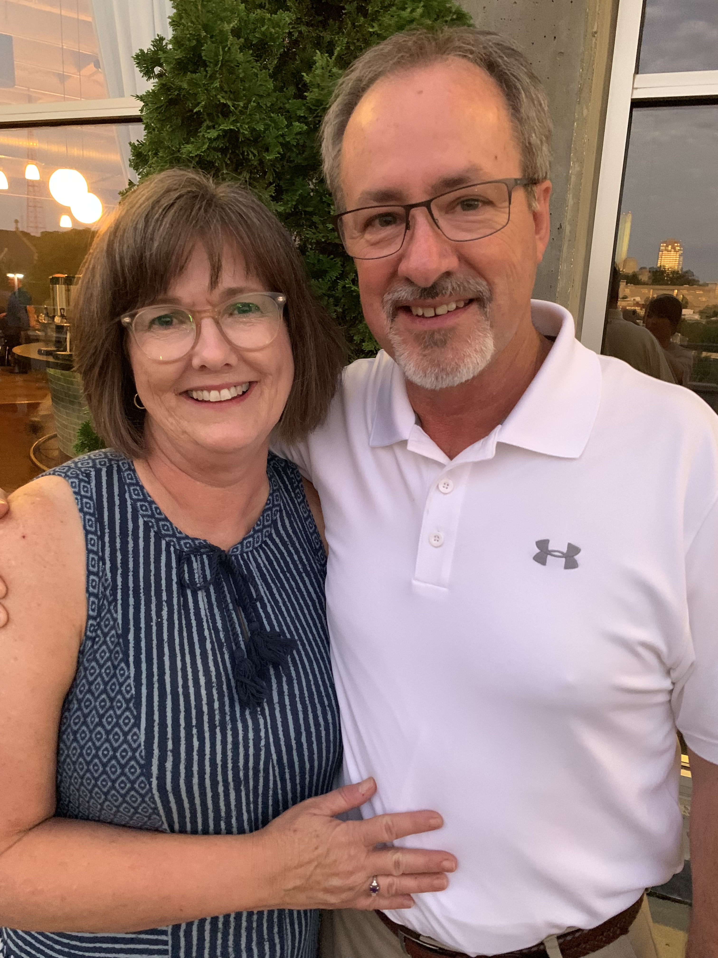
VISION

Slide 12
I counsel you to buy from me gold refined by fire, so that you may be rich, and white garments so that you may clothe yourself and the shame of your nakedness may not be seen, and salve to anoint your eyes, so that you may see. ¹⁹ Those whom I love, I reprove and discipline, so be zealous and repent.
Revelation 3:18-19
VISION

Slide 13
1. Recognize your thirst.
VISION

Slide 14
Recognize your thirst.
Comparison
Buy/eat when you are lonely depressed or bored
Irritable
I’m not _______ enough
Anxious you’ll be found out
VISION

Slide 15
Recognize your thirst.
Principle of Displacement
VISION

Slide 16
Recognize your thirst.
Principle of Displacement
In the Lord I take refuge;
How can you say to my soul,
“Flee like a bird to your mountain.”
Psalm 11:1
VISION

Slide 17
And we know that for those who love God all things work together for good, for those who are called according to his purpose.
Romans 8:28
VISION

Slide 18
Recognize your thirst.
Principle of Displacement
Repentance… so be zealous and repent (v. 19)
VISION

Slide 19
Recognize your thirst.
Principle of Displacement
Repentance… so be zealous and repent (v. 19)
Because of this, the Lord said, “You must repent of such words and thoughts!
Jeremiah 15:19
VISION

Slide 20
From whom every family in heaven and on earth is named, ¹⁶ that according to the riches of his glory he may grant you to be strengthened with power through his Spirit in your inner being, ¹⁷ so that Christ may dwell in your hearts through faith—that you, being rooted and grounded in love, ¹⁸ may have strength to comprehend with all the saints what is the breadth and length and height and depth, ¹⁹ and to know the love of Christ that surpasses knowledge, that you may be filled with all the fullness of God.
²⁰ Now to him who is able to do far more abundantly than all that we ask or think, according to the power at work within us,
Ephesians 3:15-20
VISION

Slide 21
Behold, I stand at the door and knock. If anyone hears my voice and opens the door, I will come in to him and eat with him, and he with me.
Revelation 3:20
VISION

Slide 22
Steps of Faith:
1. Vulnerable with others about your thirst.
2. Find a place to serve (Serving has a way of getting your eyes off yourself and onto others)
3. Gratitude journal (Helps with doubts about God)
VISION

