Slide 2
Why The Cross?
Mark 15:1-32

Slide 3
The beginning of the gospel of Jesus Christ, the Son of God.
Mark 1:1

Slide 4
And when the centurion, who stood facing him, saw that in this way he breathed his last, he said, “Truly this man was the Son of God!”
Mark 15:39

Slide 5
And the soldiers led him away inside the palace (that is, the governor's headquarters), and they called together the whole battalion ¹⁷ And they clothed him in a purple cloak, and twisting together a crown of thorns, they put it on him.¹⁸ And they began to salute him, “Hail, King of the Jews!” ¹⁹ And they were striking his head with a reed and spitting on him and kneeling down in homage to him.²⁰ And when they had mocked him, they stripped him of the purple cloak and put his own clothes on him. And they led him out to crucify him.
Mark 15:16-20

Slide 6
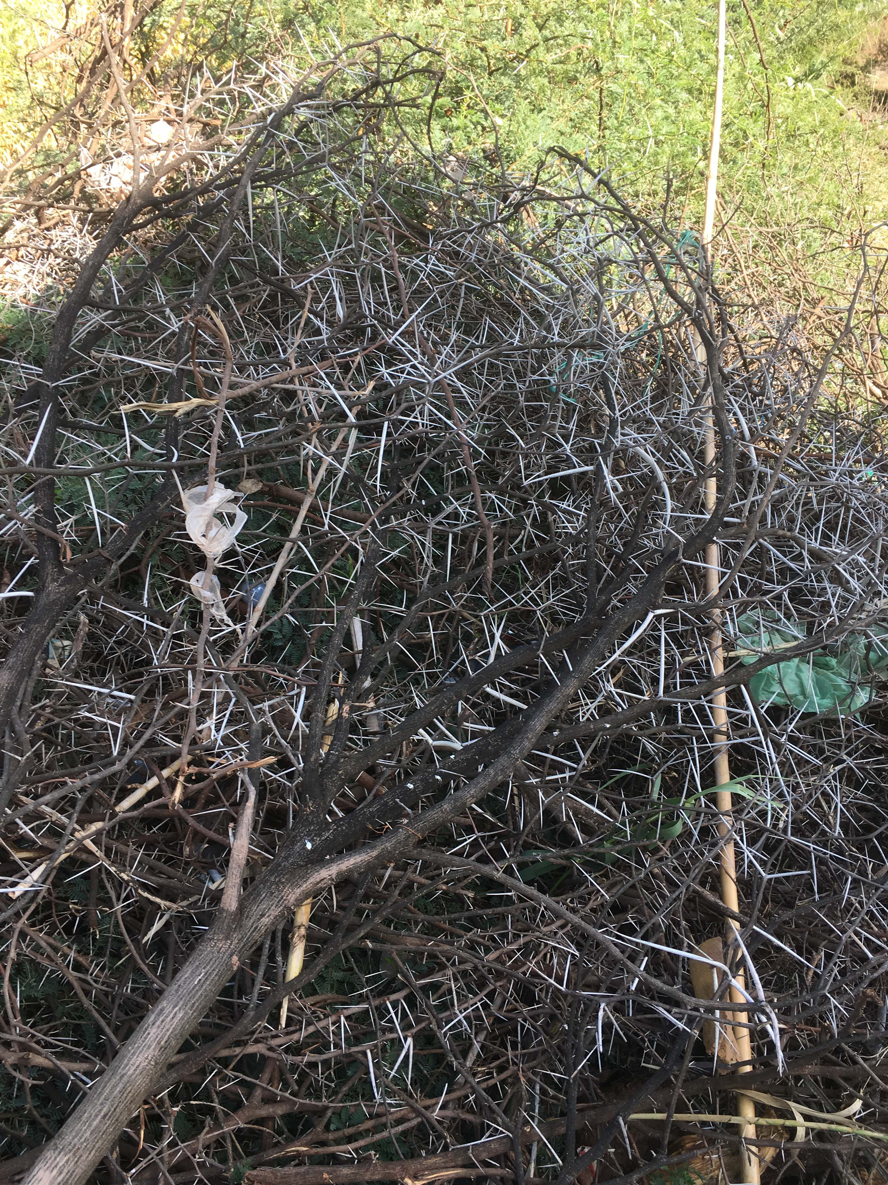

Slide 7
The Crucifixion
²¹ And they compelled a passerby, Simon of Cyrene, who was coming in from the country, the father of Alexander and Rufus, to carry his cross.
Mark 15:21

Slide 8
The Crucifixion
²² And they brought him to the place called Golgotha (which means Place of a Skull). ²³ And they offered him wine mixed with myrrh, but he did not take it.
Mark 15:22-23

Slide 9
The Crucifixion
²⁴ And they crucified him (Such a matter of fact way to say it) and divided his garments among them, casting lots for them, to decide what each should take.
Mark 15:24

Slide 10
The Crucifixion
For dogs encompass me; a company of evildoers encircles me; they have pierced my hands and feet___ ¹⁷ I can count all my bones— they stare and gloat over me; ¹⁸ they divide my garments among them, and for my clothing they cast lots.
Psalm 22:16-18

Slide 11
The Crucifixion
²⁵ And it was the third hour when they crucified him. ²⁶ And the inscription of the charge against him read, “The King of the Jews.” ²⁷ And with him they crucified two robbers, one on his right and one on his left. ²⁹ And those who passed by derided him, wagging their heads and saying, “Aha! You who would destroy the temple and rebuild it in three days, ³⁰ save yourself, and come down from the cross!”
Mark 15:25-32

Slide 12
The Crucifixion
³¹ So also the chief priests with the scribes mocked him to one another, saying, “He saved others; he cannot save himself. ³² Let the Christ, the King of Israel, come down now from the cross that we may see and believe.” Those who were crucified with him also reviled him.
Mark 15:25-32

Slide 13
The Crucifixion
³¹ So also the chief priests with the scribes mocked him to one another, saying, “He saved others; he cannot save himself. ³² Let the Christ, the King of Israel, come down now from the cross that we may see and believe.” Those who were crucified with him also reviled him.
Mark 15:25-32

Slide 14
The Crucifixion
And he died for all, that those who live might no longer live for themselves but for him who for their sake died and was raised.
2 Corinthians 5:15

Slide 15
Why the Cross?
The Reason for the cross.
What it has accomplished.

Slide 16
1. The Reason for the Cross
For even the Son of Man came not to be served but to serve, and to give his life as a ransom for many.
Mark 10:45

Slide 17
1. The Reason for the Cross
For our sake he made him to be sin who knew no sin, so that in him we might become the righteousness of God.
2 Corinthians 5:21

Slide 18
2. What did the Cross Accomplish?
All this is from God, who through Christ reconciled us to himself and gave us the ministry of reconciliation; ¹⁹ that is, in Christ God was reconciling the world to himself, not counting their trespasses against them, and entrusting to us the message of reconciliation. ²⁰ Therefore, we are ambassadors for Christ, God making his appeal through us.
2 Corinthians 5:18-20

Slide 19
Where do we need to believe the Gospel?
Where do we need to allow Him to be King of our Kingdom?

Slide 20
Where do we need to believe the Gospel?
Where do we need to allow Him to be King of our Kingdom?
1. Do we allow the Scriptures to reveal our self-centeredness?

Slide 21
Where do we need to believe the Gospel?
Where do we need to allow Him to be King of our Kingdom?
Do we allow the Scriptures to reveal our self-centeredness?
“Memorial Day” How has the truth of the Gospel impacted your life?

Slide 22
Where do we need to believe the Gospel?
Where do we need to allow Him to be King of our Kingdom?
Do we allow the Scriptures to reveal our self-centeredness?
“Memorial Day” How has the truth of the Gospel impacted your life?
Do we carry around the “luggage” of guilt/shame?

Slide 23
Where do we need to believe the Gospel?
Where do we need to allow Him to be King of our Kingdom?
Do we allow the Scriptures to reveal our self-centeredness?
“Memorial Day” How has the truth of the Gospel impacted your life?
Do we carry around the “luggage” of guilt/shame?
How has the Gospel influenced your prayers?

Slide 24
When we pray to God for His blessing, He does not examine our performance to see if we are worthy. Rather, He looks to see if we are trusting in the merit of His Son as the only hope for securing His blessing.”
Jerry Bridges

