Slide 2
Followers, Fans, and
Fighters
Mark 1:16-3:6

Slide 3
Authority over supernatural power
(Mark 1:23-26; 1:32-34)

Slide 4
Authority over supernatural power
Authority over the physical realm
(1:29-34; 1:40-42; 2:1-12)

Slide 5
Authority over supernatural power
Authority over the physical realm
Authority to forgive sins
(2:1-12)

Slide 6
Authority over supernatural power
Authority over the physical realm
Authority to forgive sins
Authority over followers
(1:16-20; 1:35-39; 2:13-14)

Slide 7
Authority over supernatural power
Authority over the physical realm
Authority to forgive sins
Authority over followers
Authority over the religious authorities
(1:21-28; 2:13-17; 2:23-28; 3:1-6)

Slide 8
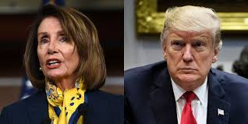
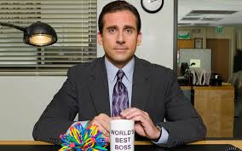

Slide 9
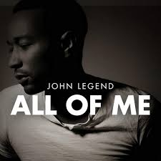
Follower
Anthem of the Heart is “All of me loves all of you”
(1:16-20; 1:35-39; 2:13-17)

Slide 10
Mark 2:13-17
Once again Jesus went out beside the lake. A large crowd came to him, and he began to teach them. As he walked along, he saw Levi son of Alphaeus sitting at the tax collector’s booth. “Follow me,” Jesus told him, and Levi got up and followed him.
While Jesus was having dinner at Levi’s house, many tax collectors and sinners were eating with him and his disciples, for there were many who followed him…

Slide 11
Mark 2:13-17
…When the teachers of the law who were Pharisees saw him eating with the sinners and tax collectors, they asked his disciples: “Why does he eat with tax collectors and sinners?”
On hearing this, Jesus said to them, “It is not the healthy who need a doctor, but the sick. I have not come to call the righteous, but sinners.”

Slide 12
Mark 1:35-39
Very early in the morning, while it was still dark, Jesus got up, left the house and went off to a solitary place, where he prayed. Simon and his companions went to look for him, and when they found him, they exclaimed: “Everyone is looking for you!”
Jesus replied, “Let us go somewhere else—to the nearby villages—so I can preach there also. That is why I have come.
So he traveled throughout Galilee, preaching in their synagogues and driving out demons.

Slide 13
2. Fan
Anthem of the Heart is: “What Have You Done For Me Lately?”
(1:21-28; 1:29-34; 1:40-45)

Slide 14
Mark 1:40-45
A man with leprosy came to him and begged him on his knees, “If you are willing, you can make me clean.”
Jesus was indignant. He reached out his hand and touched the man. “I am willing,” he said. “Be clean!” Immediately the leprosy left him and he was cleansed. Jesus sent him away with a stern warning: “See that you don’t tell this to anyone…”
Instead he went out and began to talk freely, spreading the news.

Slide 15
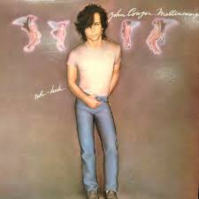
2. Fighter
Anthem of the Heart is: “I Fight Authority, Authority Always Wins”
(1:22; 2:6-12; 2:15-17; 2:18-22; 2:23-27;3:1-6)

Slide 16
Mark 1:22
The people were amazed at his teaching, because he taught them as one who had authority, not as the teachers of the law.

Slide 17
Mark 2:6-7
Now some teachers of the law were sitting there, thinking to themselves, “Why does this fellow talk like that? He’s blaspheming! Who can forgive sins but God alone?
Mark 2:16
When the teachers of the law who were Pharisees saw him eating with the sinners and tax collectors, they asked his disciples: “Why does he eat with tax collectors and sinners?

Slide 18
Mark 2:24
One Sabbath Jesus was going through the grain fields, and as his disciples walked along, they began to pick some heads of grain. The Pharisees said to him, “Look, why are they doing what is unlawful on the Sabbath?”

Slide 19
Mark 3:1-6
Another time Jesus went into the synagogue, and a man with a shriveled hand was there. Some of them were looking for a reason to accuse Jesus, so they watched him closely to see if he would heal him on the Sabbath. Jesus said to the man with the shriveled hand, “Stand up in front of everyone.”
Then Jesus asked them, “Which is lawful on the Sabbath: to do good or to do evil, to save life or to kill?” But they remained silent.
He looked around at them in anger and, deeply distressed at their stubborn hearts, said to the man,

Slide 20
Mark 3:1-6
…“Stretch out your hand.” He stretched it out, and his hand was completely restored. Then the Pharisees went out and began to plot with the Herodians how they might kill Jesus.

Slide 21
What is the anthem of your heart?
“All of me loves all of you”? Are you a follower who delights in the beauty of Christ’s authority?
“What have you done for me lately?” Are you a fan who pursues Christ for what he does for you, but rejects his authority?
“I fight authority, authority always wins”? Do you fight Jesus’ authority, viewing it as a threat to the authority over your own life?

